Slide 1
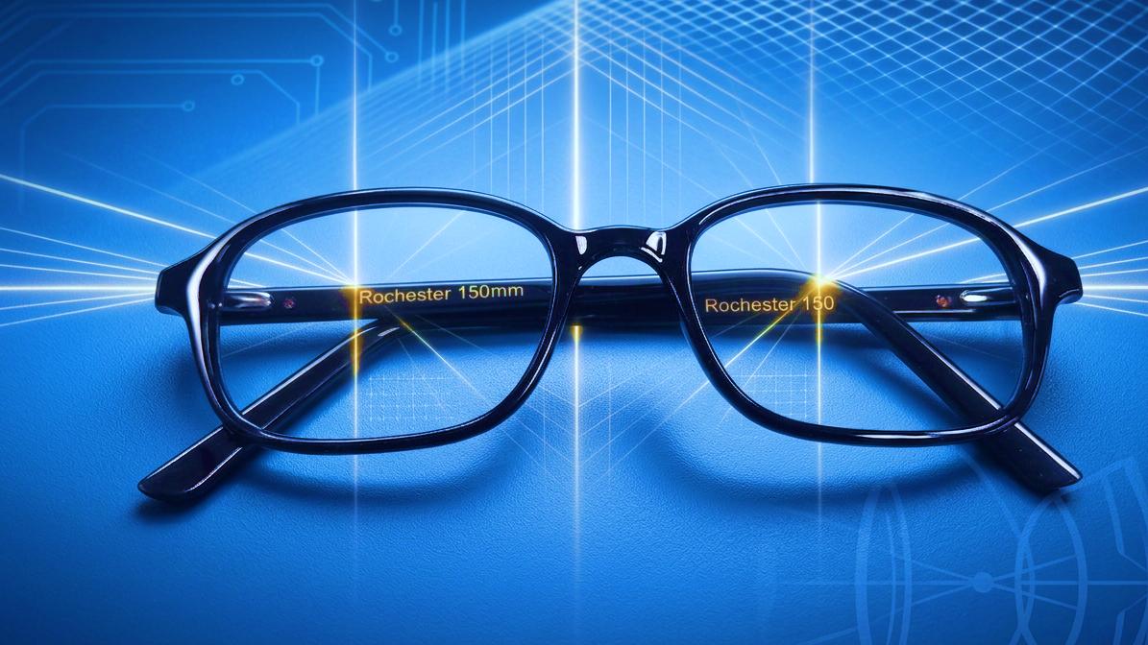
Welcome to Your New Progressive Lenses!
A Guide for First-Time Wearers

Slide 2
What Are Progressive Lenses?
Think of them as 'no-line' multifocal lenses.
They provide a smooth, seamless transition between different visual zones.
Three main zones for clear vision at all distances: Distance, Intermediate, and Near.
This means no more 'image jump' like with traditional bifocals.

Slide 3

Getting to Know Your Visual Zones
DISTANCE ZONE (Top): For seeing things far away, like driving, watching TV, or looking across the room.
INTERMEDIATE ZONE (Middle): Perfect for computer screens, seeing the car dashboard, or looking at someone across a desk.
NEAR ZONE (Bottom): For close-up tasks like reading a book, using your smartphone, or seeing a menu.

Slide 4
The Golden Rule: Point Your Nose!
This is the most important tip for adapting to your new lenses.
To see something clearly, point your head and nose directly at it.
Don't just move your eyes side-to-side, as this will lead you into the softer, less clear peripheral areas of the lens.

Slide 5

Navigating Your World
Walking & Stairs: Look straight ahead and tilt your chin down slightly to see the ground or steps through the top (distance) part of the lens.
Computer Use: Position your monitor so you are looking through the middle (intermediate) part of the lens without tilting your head back.
Reading: Hold your reading material at a comfortable level and look down through the bottom (near) part of your lenses.

Slide 6
Understanding the 'Swim' Effect
The sides of progressive lenses contain peripheral distortion, which can create a 'swim' or 'sway' feeling at first.
This is a normal part of the lens design.
Your brain is amazing! It will learn to ignore these areas over time as you adapt.
'Pointing your nose' helps you stay in the clearest part of the corridor and avoid this effect.

Slide 7
The Crucial Adaptation Period
Be patient! It takes time for your brain and eyes to get used to the new way of seeing.
The adaptation period can last from a few days to a couple of weeks.
The best way to adapt is to wear your new glasses full-time. Avoid switching back and forth with old pairs.

Slide 8
Tips for Success
Commit
Commit to wearing them: Make them the first thing you put on in the morning and the last thing you take off at night.
Practice
Practice: Consciously practice looking from distance to near, like watching TV and then looking at your phone.
Check
Check the Fit: Ensure the frames are sitting correctly on your face. If they slide down, the viewing zones will be out of position.

Slide 9
When to Contact Your Optician
If you experience ongoing dizziness, headaches, or eye strain after the first one to two weeks.
1
If you must uncomfortably tilt your head up to read or down to see in the distance.
2
Your optician can make small adjustments to the frame or re-check the measurements to ensure a perfect fit for you.
3

